Slide 1




Blockchain Fundamentals
Sarang Parikh
Order of Satoshi | nmit.ac.in/blockchain
Notes:
http://www3.weforum.org/docs/WEF_The_future_of_financial_infrastructure.pdf

Slide 2





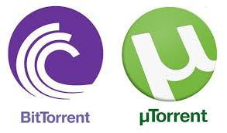

Blockchain Fundamentals
Client Server vs Peer to Peer
Centralized Systems
Distributed Ledger
Slow, dependant, siloed system
Secure
shared source
of truth
Expensive
and
bloated
Need for a central authority
No need for central authority
Real-time data sharing
Corruptible, censorable, deletable
Immutable, uncensorable

Slide 3
Blockchain Fundamentals
What is the incentivisation for providing file ?

Slide 4
Blockchain Fundamentals
Blockchain @ 30,000ft

Slide 5
Blockchain Fundamentals
What is Blockchain?
Blockchain represents the culmination of decades of research in cryptography and distributed systems and includes four key innovations brought together in a unique and powerful combination.
A de-centralized peer-to-peer network (the bitcoin protocol)
A public transaction ledger (the blockchain)
A de-centralized mathematical and deterministic currency issuance (distributed mining)
A de-centralized transaction verification system (transaction script).

Slide 6
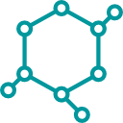
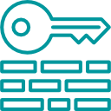

Blockchain Fundamentals
What is Blockchain?
Decentralized Consensus
There are many replicas of the blockchain database and no one participant can tamper it. Consensus among majority participants is needed to update the database.
Immutable ledger
Blockchain is a write-once database so it records an immutable record of every transaction that occurs.
Cryptographically Secure
Uses tried and true public/ private signature technology. Blockchain applies this technology to create transactions that are impervious to fraud and establishes a shared truth.
Smart contracts
The Ethereum blockchain can store both data and Smart Contract (“logic”) in the blockchain

Slide 7
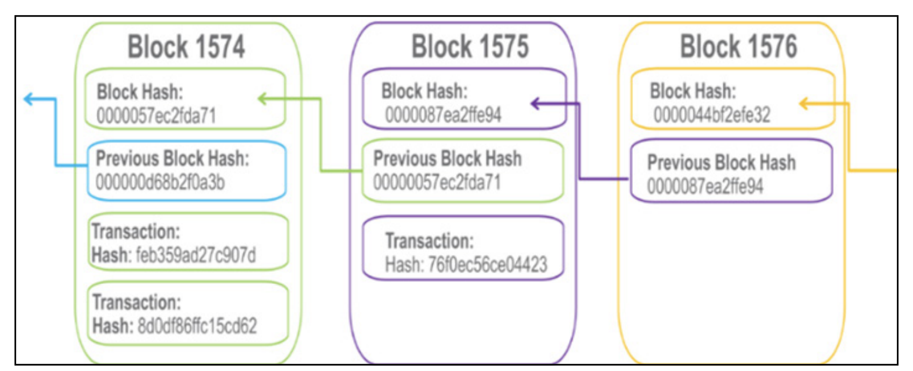
Blockchain Fundamentals
What is Blocks?
Blockchain owes its name to the way it stores transaction data — in blocks that are linked together to form a chain. As the number of transactions grows, so does the blockchain. Blocks record and confirm the time and sequence of transactions, which are then logged into the blockchain, within a discrete network governed by rules agreed on by the network participants

Slide 8
Blockchain Fundamentals
Blockchain Components

Slide 9
Blockchain Fundamentals
Transaction
A blockchain is a globally shared, transactional database. This means that everyone can read entries in the database just by participating in the network.
If you want to change something in the database, you have to create a so-called transaction which has to be accepted by all others.
The word transaction implies that the change you want to make (assume you want to change two values at the same time) is either not done at all or completely applied. Furthermore, while your transaction is applied to the database, no other transaction can alter it.
Furthermore, a transaction is always cryptographically signed by the sender (creator). This makes it straightforward to guard access to specific modifications of the database. In the example of the electronic currency, a simple check ensures that only the person holding the keys to the account can transfer money from it.

Slide 10
Blockchain Fundamentals
Blocks
Every ten minutes on average, miners generate a new block that contains all the transactions since the last block.
New transactions are constantly flowing into the network from user wallets and other applications.
As these are seen by the bitcoin network nodes, they get added to a temporary “pool” of unverified transactions maintained by each node.
As miners build a new block, they add unverified transactions prioritized by the highest-fee transactions from this pool to a new block and then attempt to solve a very hard problem (aka Proof-of-Work) to prove the validity of that new block.
The process of mining is explained in detail in later section.

Slide 11
Blockchain Fundamentals
How does it Work?
You need a lot of computers talking to each other
The are called nodes on the network
Transactions can be submitted to any node
The nodes send any transactions they receive to all the nodes they are connected to
Those node send the transactions on to the nodes they are connected to
Eventually all the nodes get a copy of the transaction
At this stage the transaction is not yet processed
The transactions get put into a batch for processing (generally called a block of transactions)
Each node processes the same transactions in the same block (that’s called consensus)
How we reach consensus is covered in the next slide

Slide 12
Blockchain Fundamentals
How does it Work?
Reaching consensus
One of the nodes has to be the leader
The leader's job is to create the next batch of transactions (block) and let every other node on the network know “These are the transactions we are processing”
How is the leader chosen? - It depends
Many public blockchains use Proof of Work (Meritocracy). You have the right to be leader because you have worked hard. It’s a good system. So for every block everyone works hard for the right to lead that round.
Proof of Stake (Capitalism). You have the right to be leader because you have invested a lot of money into the network
RAFT (Democracy). Each leader is elected by the other nodes and has a term of office. His leadership terminates when his term is over or he dies. Then the next leader is elected
Round Robin (Oprah Winfrey leadership). Everyone gets a turn to be leader
Proof of Authority (Monarchy)
Single leader for life (Dictatorship)

Slide 13
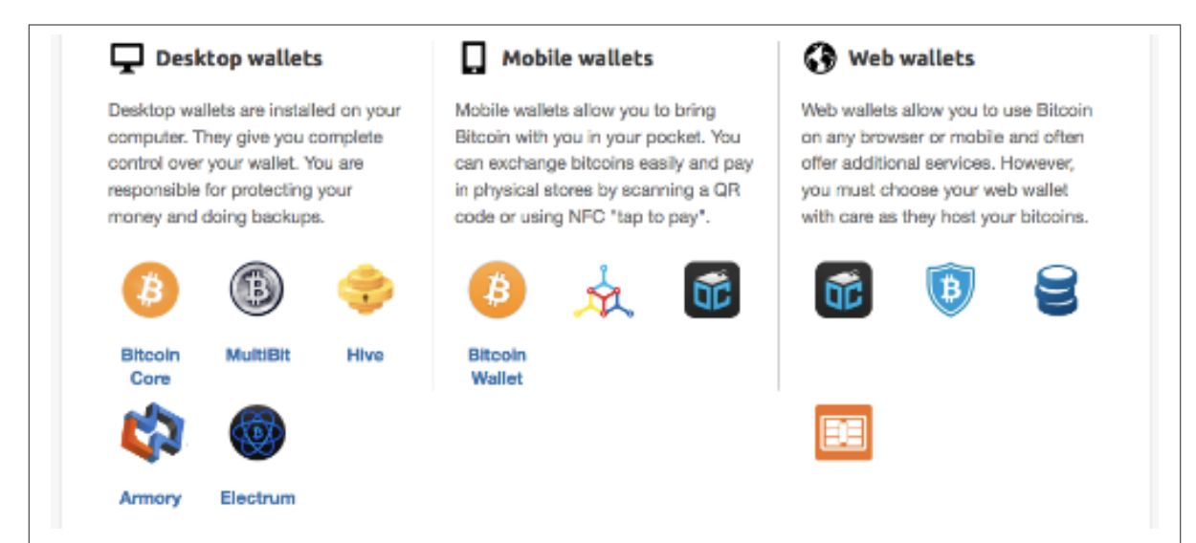
Blockchain Fundamentals
Clients

Slide 14
Blockchain Fundamentals
Ethereum Blockchain

Slide 15

Blockchain Fundamentals
What is Ethereum Anyway
Ethereum was built to extend the blockchain concept with the ability to also run veridical business logic (Smart Contracts) using a decentralised network, creating a globally distributed World Computer
Ethereum value proposition
Builds on the Blockchain concepts of Cryptographic Security, Decentralisation and Immutability
Adds in the capability to run decentralised Smart Contracts, a Turing complete programming language running in the Ethereum Virtual Machine
Supports private permissioning and additional privacy features while maintaining interoperability with the public chain
Under active development by the Ethereum Foundation, the platform continues to grow in terms of both Enterprise adoption and also functionality
With the establishment of the Enterprise Ethereum Alliance, Ethereum is becoming the de-facto blockchain technology of choice for enterprise projects
“
Think of Ethereum as a world computer.
What Bitcoin does for payments, Ethereum does for anything that can be programmed.
Vitalik Buterin, Ethereum Inventor
”

Slide 16
Blockchain Fundamentals
Accounts
Two types of Accounts
Externally owned accounts (EOAs)
Contract accounts
Externally owned accounts (EOAs)
has an ether balance,
can send transactions (ether transfer or trigger contract code),
is controlled by private keys,
has no associated code.
Contract accounts
has an ether balance,
has associated code,
code execution is triggered by transactions or messages (calls) received from other contracts.
when executed - perform operations of arbitrary complexity (Turing completeness) - manipulate its own persistent storage, i.e. can have its own permanent state - can call other contracts

Slide 17
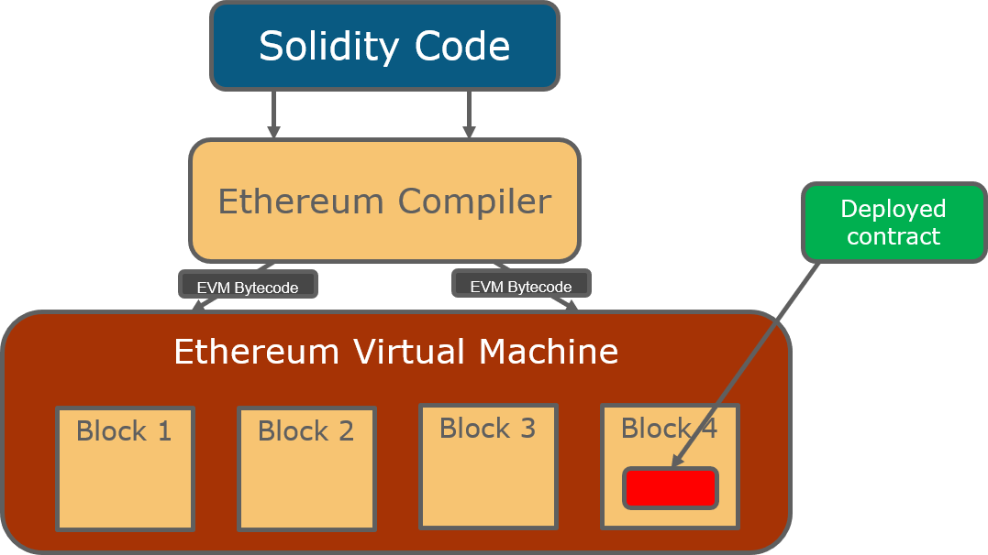
Blockchain Fundamentals
Ethereum Virtual Machine (EVM)
The Ethereum Virtual Machine or EVM is the runtime environment for smart contracts in Ethereum.
The contract code is executed by the Ethereum Virtual Machine on each node participating in the network as part of their verification of new blocks.

Slide 18
Blockchain Fundamentals
Network
The ethereum network is a public blockchain network.
It forms the basis of all decentralized peer-to-peer applications and organizations run on the network
The network is comprised of two types of nodes namely, full nodes and light-weight-nodes.
Full nodes contain the entire history of transactions since the genesis block. They are a full-fledged proof of the integrity of the blockchain network. Full nodes have to contain each and every transaction that has been verified according to the rules set up by Ethereum’s specifications.
Light-weight nodes on the other hand only contain a subset of the entire blockchain. These types of nodes are mostly used in e-wallets which have to be light-weight in nature and hence the entire blockchain cannot be stored on them. These nodes, in contrast, do not verify every block or transaction and may not have a copy of the current blockchain state. They rely on full nodes to provide them with missing details (or simply lack particular functionality). The advantage of light nodes is that they can get up and running much more quickly, can run on more computationally/memory constrained devices, and don’t eat up nearly as much storage.

Slide 19
Blockchain Fundamentals
Transaction Lifecycle

Slide 20
Blockchain Fundamentals
Parameters of a Transaction - Construction
The function call is first converted in to a raw transaction (rawTxn).
Web3js library is used to build the raw transaction object.
Let’s try to understand all the fields in the raw transaction object and how they are set.
Nonce
gasPrice
gasLimit
To
Value
Data

Slide 21
Blockchain Fundamentals
Signing of Transaction
If you remember, you used web3.eth.accounts[0] to execute the transaction.
The Ethereum network needs to know that you actually own that account to make sure someone else doesn’t execute this transaction on your behalf.
The way to prove this to the network is by signing the transaction using the private key corresponding to that account.

Slide 22
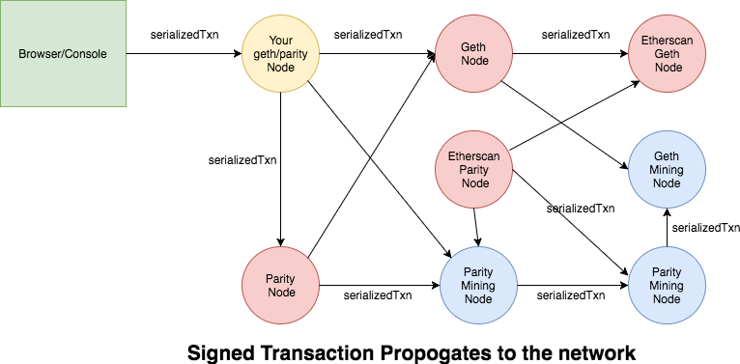
Blockchain Fundamentals
Broadcast of Transaction
The signed transaction is broadcast by your geth/parity node to it’s peers who in turn broadcast to their peers and so on.
Once the transaction is broadcast to the network, your local node also outputs the transaction id which you can use to track the status of your transaction.
This transaction id is just the hash of the signed transaction object.

Slide 23
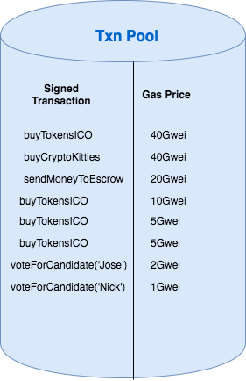
Blockchain Fundamentals
Miner Accepts the Transaction
As you probably know, the miners are the ones who do the job of including your transaction in the block.
Miners maintain a transaction pool where your transaction gets added to before they start evaluating it.
If you notice the picture above, the miners store all the transactions in the pool sorted by gas price.
The higher the gas price, the more likely the transaction is included in the next block.
This is the common configuration for a miner node (to optimize for higher pay). However, a miner can configure her node to sort the transactions however they like (say they want to help the network by mining only low gas transactions).

Slide 24
Blockchain Fundamentals
Miner node finds a valid block and broadcasts to the network
The miner eventually picks our transaction to include in the block along with other transactions.
The miner can only pick so many transactions to include in the block because Ethereum has set a block gas limit. i.e, the sum of all the gas limits on the transactions can not exceed the block gas limit.
Once the miners select the transactions to include in the block, the transactions are validated and included in a pending block and the Proof of Work begins.
One of the miner nodes eventually finds a valid block (by solving the PoW puzzle) and adds that block to the blockchain.
Just like the raw transaction was broadcast by your local node which was received by all other nodes, the miner node broadcasts this valid block to other nodes.

Slide 25
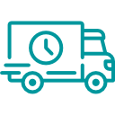








High potential use cases
Art of the Possible
Blockchain applications are emerging across many industries
Supply Chain
Provenance of assets become verifiable and traceable leading to the revolution of supply chains.
Governance
DAOs built on blockchains to maintain transparency and governance.
Self-sovereign identity
People and business own their own identity, with no central control, and build universal reputation.
Medical records
Personal ownership of medical records that can be used universally.
Decentralized storage
Does not require additional backups and disaster recovery. No central point of failure and control.
Creative work
Art ownership and distribution, where creators receive direct compensation for their work.
Fundraising
Initial Coin Offerings (ICOs) emerging as an alternative to venture capital.
IoT
Blockchain used as a means to connect and audit IoT, M2M value transfer.
Commodities trading
Tokenization, tracking and p2p trading of commodities, such as energy.

